Slide 1
PayPal as payment method

Slide 2
Case Study Overview
Objective: Integrate PayPal 2.0 as a payment method in the payment gateway.
Scope: Implement authorization, capture, refund, and reporting functionalities using PayPal SDK.

Slide 3
Application Introduction
Defining Requirements
Components Mapping
Technical Design
Technology Stack

Slide 4

Pay flexibly with PayPal
Image Credit: https://www.paypal.com/ca/business/resources/logos-and-banners

Slide 5

Secure Payment method
With over 173 million users globally and operates in 202 countries
Support in 21 different currencies
Zero Subscription Fee
Secure Transfers
Convenient to use
Hassle-free Subscription Services

Slide 6
Requirements
Functional
Non Functional
What the system should do
What the system should deal with
Payment (2 Step integration)
Payment Authorization
Payment Capture
Payment – Fastlane required?
Refund Processing
Transaction Logging
Transaction Reporting

Slide 7
Non Functional
How many concurrent users? At least 200 per minute
How many refunds will be processed At least 50
Per day?
How much transaction throughput? At least 500 per minute
What is the target payment authorization response time? < 2 Seconds
What is the required system availability? 99.99%
How quickly should refunds be processed? < 1 hour
Which transactions need to be logged? All transactions
How many years these data has to be stored? As per GDPR
…..contd

Slide 8
Non Functional
How scalable should the system be? Scalable to handle a 50% increase in peak transaction load
What is the acceptable error rate for transactions? < 0.5%
Which security standards must be followed? must comply with PCI DSS and implement SSL/TLS encryption
When should data backups be performed? at least 30 days.
What is the disaster recovery objective? recovery time objective (RTO) of less than 1 hour.

Slide 9
Client’s Current Payment Landscape:
Assuming Client’s payment gateway has following:
Handling various payment methods including credit cards, debit cards, Internet Banking
Has API interaction with VISA, MasterCard and other payment interfaces for direct debit from bank account.
Has custom data management to store transaction history
Fraud Detection
Reporting of transaction for any metric analysis
Cancellation Page when payment is cancelled or authorization is denied by payment provider.

Slide 10
Client’s Current Payment Landscape:
Assuming Client’s payment gateway does not have:
Buy Now Pay Later option
Support for international transactions i.e. only domestic credit/debit cards are
accepted.
Support of any specific card payment network like American Express, Discover etc.

Slide 11
PayPal Integration Service - Purpose
The purpose of developing the PayPal Integration Service is to securely and efficiently integrate PayPal as a payment method within the client’s existing payment gateway, allowing the client to offer PayPal as an additional payment option. This service manages the entire payment lifecycle—authorizing, capturing, and refunding payments—through PayPal's API, ensuring seamless operation within the client’s gateway, compliance with security standards, and real-time transaction updates for an enhanced customer and merchant experience.
PayPal handles the existing client’s challenges by offering
Buy Now, Pay Later Option using “Pay Later” or “Pay after 30 days” feature
Support for International Transactions and
Enables multi-currency support
Expands global market reach
Support for Specific Card Networks
Supports American Express, Discover and all other world renowned payment networks.
Broadens payment options for customers

Slide 12
Monolithic vs. Microservices
A Comparative Analysis for PayPal Integration

Slide 13
Pros
Criteria | Monolithic Architecture | Microservices Architecture
Functional Requirements | - Unified codebase simplifies management of interdependencies | - Modularity allows for clear separation of concerns
 | - Easier and faster development of features | - Independent development and deployment of services
 | - Consistent data management across the application | - Flexibility to use different technologies for each service
 | - Simpler testing as all components are in one place | - Easier to scale specific functions (e.g., payment processing)
Non-Functional Requirements | - Better performance due to in-process communication | - Superior scalability with independent scaling of services
 | - Simpler and quicker deployment process | - Enhanced resilience; failure in one service doesn’t impact others
 | - Easier to maintain data consistency with a single database | - Fault isolation minimizes risk of cascading failures
 | - Lower operational overhead as everything is in one application | - Flexibility and adaptability to changing business requirements
 | - Easier logging and monitoring in a single application | - Better suited for continuous delivery and frequent updates

Slide 14
Cons
Criteria | Monolithic Architecture | Microservices Architecture
Scalability | Difficult to scale individual components independently | Increased complexity in managing multiple services
Maintenance | Codebase can become large and complex over time | Requires robust DevOps practices and higher operational overhead
Deployment | Even small changes require redeploying the entire application | More complex deployment processes due to multiple services
Flexibility | Limited flexibility in adopting new technologies due to tight coupling | Challenges in maintaining data consistency across services
Reliability | A failure in one part can bring down the entire system | Network latency due to inter-service communication
Testing | Simpler but affects entire system if issues arise | More complex testing processes for individual services

Slide 15
Integration of an Instant Payment Solution into the Client’s IT Payment Landscape
PayPal Integration Service can be developed separately as microservice and the Integration API can be called from the existing gateway. If client payment gateway is monolithic, this service can be integrated as hybrid architecture.
API
Endpoint
Existing Payment Gateway
PayPal Integration Service

Slide 16
Hybrid (if monolithic) or Microservices Architecture
Hybrid architecture helpful
Incremental Migration and modernization.
Flexibility
Improved Scalability
Isolation
Improved Maintenance

Slide 17
Scope of Work:
Obtain and Manage OAuth 2.0 Access Tokens:
Securely obtain and manage OAuth 2.0 access tokens from PayPal to authenticate API requests, ensuring all communication with PayPal’s services is authorized.
Payment Authorization:
Send requests to PayPal to verify and hold funds on the customer’s payment method, ensuring that the payment can be captured later.
Capture Authorized Payments:
Finalize the payment by capturing the authorized funds, transferring the amount from the customer’s account to the merchant’s account.
Refund Processing:
Handle refund requests by interacting with PayPal to return funds to the customer for previously captured payments.
Transaction Logging and Auditing:
Record all transaction details and events for future reference, ensuring that every payment and refund is auditable.
Validation, Error Handling and Retry Logic:
Implement mechanisms to gracefully handle errors during API interactions and automatically retry operations when transient issues occur.
7. Security and Compliance Ensure that all processes and data handling adhere to security standards and compliance requirements, such as PCI DSS, to protect sensitive payment information.
8. API Rate Limiting and Idempotency:
Monitor and manage API request rates to avoid hitting PayPal’s limits, and implement idempotency to prevent duplicate transactions.
9. Webhook Integration:
Set up webhook listeners to receive real-time notifications from PayPal about payment status updates, disputes, and other important events

Slide 18
PayPal Integration API - Key Components
Based on requirements:
Authorize Payment
Capture Payment
Refund Processing
Transaction History Report
Authorize Payment
Capture Payment
Refund
Transaction History
Pass the (payer) user data for authorization
Process the payment
Authorize user and payment and initiate refund
Log transaction and display history
PayPal API
Datastore

Slide 19
Authorization Service: What It Does
Request:
Sends user data and payment amount to the PayPal API for authorization.
Verifies buyer's funds and reserves the amount for debit.
Response:
Returns an authorization status: Approved or Denied, along with an authorization ID.
Provides a response message:
Success: User is authorized, and sufficient funds are available.
Error: User is not authorized due to insufficient funds, or no card/account is linked.
What It Doesn't Do:
Does not capture the payment.
Does not persist any information.

Slide 20
What it does?
Payment Service:
1. Request:
Send the authorization data fetched from authorization
Service to PayPal API
2. Response
Transaction Status from payment provider
Status can be
Payment success
Payment failed
Payment Process Cancelled by the user.
3. Persists the transaction information to the persistence unit

Slide 21
What it does?
Refund Service:
1.Request:
Sends transaction data such as ID, refund amount, reason (optional)
2. Response
Status of refund processing with message
3.Persists the transaction information

Slide 22
What it does?
Transaction reporting Service:
Fetches the transaction data based on criteria
Ex –
By Geographical location
By Date and time
By User
By type (refund or normal payment)
etc

Slide 23

Application Type
Web App & Web API
Mobile App
Console
Service
Desktop App

Slide 24
Technical Design
Considerations:
Should be able to connect to PayPal SDK
Should be able to communicate to the client payment gateway services.

Slide 25
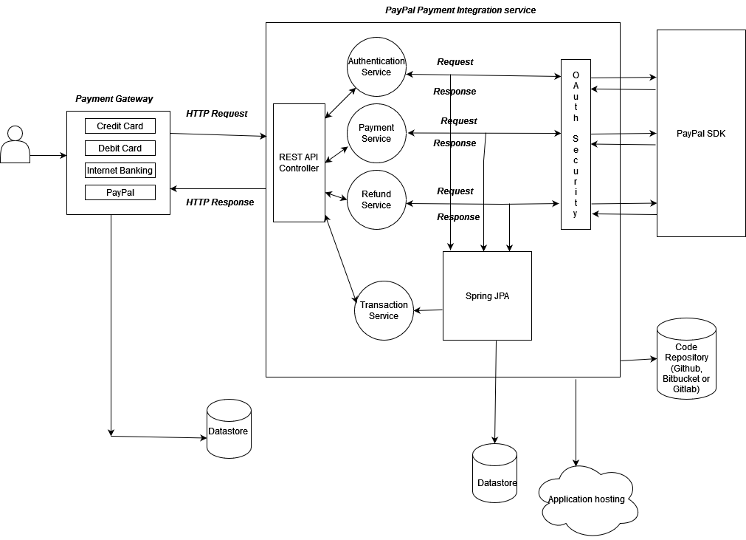
Technology Design

Slide 26




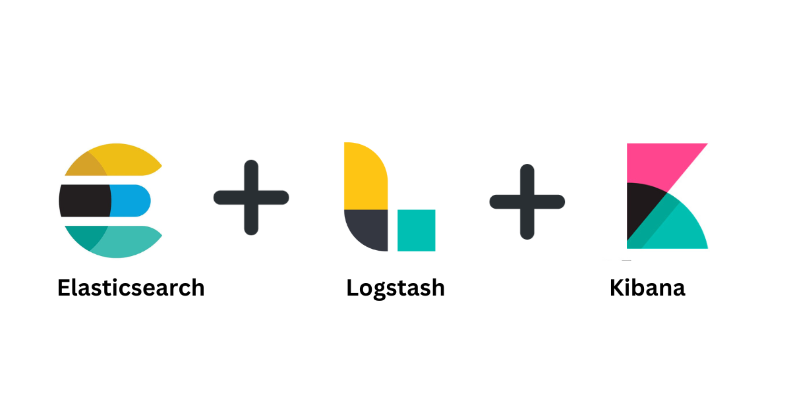


Technology Stack

Slide 27
Technology Stack
Business Layer Implementation ( Java, Spring Boot, Rest API)
Dependency Management - Maven
Security - OAuth2
Payment Gateway Integration: Paypal SDK

Slide 28
Technology Stack
Testing – Spring Test, Mockito
Messaging/Asynchronous Processing - Apache Kafka, RabbitMQ
Monitoring and Logging – ELK Stack for distributed environment
Deployment – Based on existing Client application (explained in later slide)
Infrastructure – Based on existing client application (explained later)
Versioning – Same version management as client’s application mostly

Slide 29
Technology Stack
What about persisting the transaction history?

Slide 30
Technology Stack
What about persisting the transaction history?
The service can utilise the transaction history storage unit of the client’s payment gateway application. But it loses it autonomy as a microservice.
Pros | Cons
Simplified Data Access | Tight Coupling
Easier Transition | Schema Dependencies
Consistent Data | Reduced Scalability
Reduced Duplication | Compromised Autonomy
Less Initial Setup | Complex Transaction Management
 | Security and Access Control Issues
 | Data Integrity Risks
 | Hinders Full Microservices Adoption

Slide 31
Technology Stack
What about persisting the transaction history? A separate NoSQL based persistence will be a good option.
Alternatives: Relational DBs or NOSQL DB
Pros | Cons
Data Isolation | Increased Complexity
Scalability | Higher Costs
Optimized Performance | Data Synchronization
Enhanced Security | Potential Redundancy
Simplified Backups | Transaction Complexity
Flexibility in Technology | Latency Overheads

Slide 32
DevOps Alternatives
Scenario | Existing Client Application | New Payment Service as Microservice (Alternatives)
Infrastructure | On-premises servers or VMs running the monolithic application | Deploy the new service as a separate VM Or Containerized environment (Docker) Or Cloud-based infrastructure Or Use cloud VMs like EC2 integrated with on-premises VMs
 | Containerized environment (Docker) Or Cloud-based infrastructure | Similar infrastructure extending the existing infrastructure

Slide 33
DevOps Alternatives
Scenario | Existing Client Application | New Payment Service as Microservice (Alternatives)
Deployment | Deployed on-premises with traditional CI/CD pipelines | - CI/CD pipelines for containerized deployment (e.g., Jenkins, GitLab CI)
 | Deployed in VMs with manual updates | Cloud-based CI/CD (AWS CodePipeline, Azure DevOps) Automated deployments with Kubernetes Helm or Docker Compose Serverless deployment (AWS Lambda with automated deployments)

Slide 34
DevOps Alternatives
Scenario | Existing Client Application | New Payment Service as Microservice (Alternatives)
Scaling | On-premises servers or VMs with manual scaling | Auto-scaling with Kubernetes or Docker Swarm Or Cloud auto-scaling (AWS Auto Scaling, Azure Scale Sets Or Serverless auto-scaling (e.g., AWS Lambda scales automatically)
 | Cloud Based Or Containerized environment with manual scaling | Horizontal scaling by adding more containers Or Hybrid approach using cloud burst for peak demand

Slide 35
DevOps Alternatives
Scenario | Existing Client Application | New Payment Service as Microservice (Alternatives)
Load Balancing | On-premises load balancers | Cloud-based load balancers (AWS ELB, Azure Load Balancer) Or Kubernetes Ingress or Service Mesh for internal load balancing Or API Gateway for external load balancing and routing Or Hybrid load balancing using a combination of on-prem and cloud
 | Cloud Based Or Kubernetes | Extending the similar load balancing for the new service

Slide 36
References:
https://developer.paypal.com/docs/checkout/standard/customize/authorization/
https://developer.paypal.com/docs/api/payments/v2/
https://spring.io/projects/spring-restdocs
https://medium.com/@umasree.kollu/building-payment-functionality-with-spring-boot-step-by-step-guide-8f2210101c5c
https://kennybrast.medium.com/how-to-explain-hybrid-devops-to-the-c-suite-without-getting-fired-95541673c023
https://aws.amazon.com/what-is/cloud-bursting/

Slide 37


